Slide 1
Client-Side Attacks
A client-side attack is a security breach that happens on the client side. Examples include installing malware on your device or banking credentials being stolen by third-party sites. A common client-side attack is a denial of service attack, which floods a system with requests and prevents it from functioning properly.
Types of Client-Side Attack:
1.Content Spoofing
2.Cross-site scripting
3.Session Fixation Attack

Slide 2
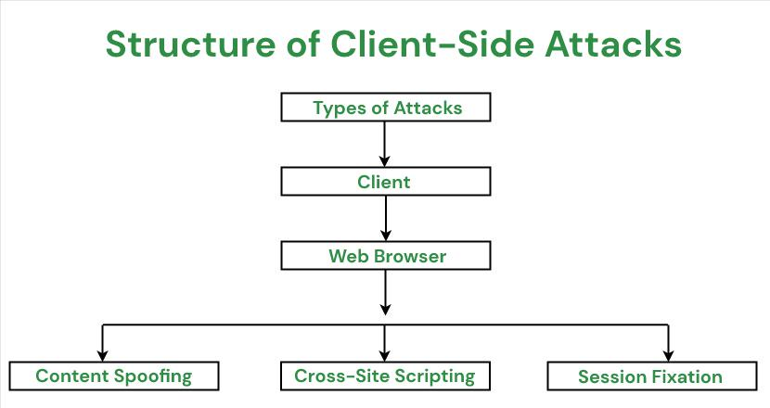
Client-Side Attacks Flow Diagram:

Slide 3
How to test Security Testing:
We can perform security Testing Manually or otherwise we can go with Automation Testing with help of below tools:
Security Testing Tools & Key Features:
Burp Suite tool --> It is a set of tools used for penetration testing of web applications
Astra Pentest Platform --> Continuous pentesting, CI/CD integration, scan behind login, cloud pentest
NMap --> Network exploration, port scanning, network mapping
WireShark--> Packet analyzer, network troubleshooting, protocol analysis
OpenVAS --> Vulnerability scanning
Metasploit --> Helps you write, test, and execute exploit code

Slide 4
Techniques to Help You Do Security Testing Manually:
Monitor Access Control Management.
Dynamic Analysis (Penetration Testing)
Static Analysis (Static Code Analysis)
Check Server Access Controls.
Ingress/Egress/Entry Points.
Session Management.
Password Management.
Brute-Force Attacks.

Slide 5
How we can implement in MGT Application:
We can check whether any Credentials details like username and password is displaying without encrypted form in Payload (F12 screen)
We can check whether only our Application related API are hitting the server.
we can scan our application in any open source tool to check any Vulnerability & Security Scanning issues.
We can check time out session is applicable when we are in ideal time
Check cookies and session time for application

